Slide 1
Cloud Computing
SEWP ZG527

Slide 2
Agenda
o Introduction to PaaS
o Building blocks of PaaS
o Characteristics of PaaS
o Advantages and Risks
o PaaS Example – Windows Azure

Slide 3
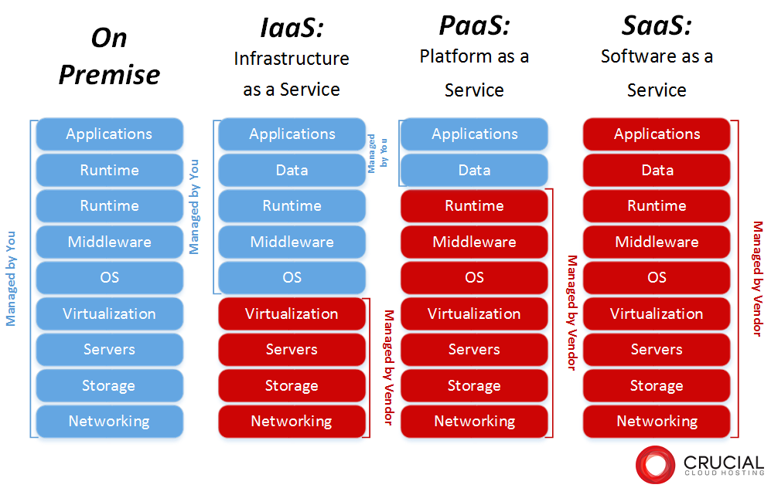
Dependency on IaaS and PaaS
Notes:
RL 4.1

Slide 4
Introduction to PaaS
Platform as a Service, referred to as PaaS, is a category of cloud computing that provides a platform and environment to allow developers to build applications and services over the internet.
Platform as a Service allows users to create software applications using tools supplied by the provider.
PaaS services are hosted in the cloud and accessed by users simply via their web browser.
PaaS services can consist of preconfigured features that customers can subscribe to; they can choose to include the features that meet their requirements while discarding those that do not.

Slide 5
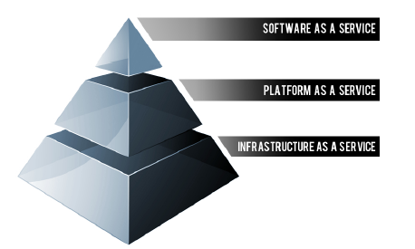
Building blocks of PaaS
PaaS providers can assist developers from the conception of their original ideas to the creation of applications, and through to testing and deployment.
Below are some of the features that can be included with a PaaS offering:
Operating system
Server-side scripting environment
Database management system
Server Software
Support
Storage
Network access
Tools for design and development
Hosting

Slide 6
Characteristics of PAAS
Services to develop, test, deploy, host and maintain applications in the same integrated development environment. All the varying services needed to fulfill the application development process
Web based user interface creation tools help to create, modify, test and deploy different UI scenarios
Multi-tenant architecture where multiple concurrent users utilize the same development application
Built in scalability of deployed software including load balancing and failover
Integration with web services and databases via common standards
Support for development team collaboration – some PaaS solutions include project planning and communication tools
Tools to handle billing and subscription management

Slide 7
Characteristics of PAAS
PaaS, which is similar in many ways to Infrastructure as a Service, is differentiated from IaaS by the addition of value added services and comes in two distinct flavours;
A collaborative platform for software development, focused on workflow management regardless of the data source being used for the application. An example of this approach would be Heroku, a PaaS that utilizes the Ruby on Rails development language.
A platform that allows for the creation of software utilizing proprietary data from an application. This sort of PaaS can be seen as a method to create applications with a common data form or type. An example of this sort of platform would be the Force.com. PaaS from Salesforce.com which is used almost exclusively to develop applications that work with the Salesforce.com CRM

Slide 8
Advantages and Risks
Advantages
Users don’t have to invest in physical infrastructure
PaaS allows developers to frequently change or upgrade operating system features. It also helps development teams collaborate on projects.
Makes development possible for ‘non-experts’
Teams in various locations can work together
Security is provided, including data security and backup and recovery.
Adaptability; Features can be changed if circumstances dictate that they should.
Flexibility; customers can have control over the tools that are installed within their platforms and can create a platform that suits their specific requirements. They can ‘pick and choose’ the features they feel are necessary.

Slide 9
Advantages and Risks
Risks
Since users rely on a provider's infrastructure and software, vendor lock-in can be an issue in PaaS environments.
Other risks associated with PaaS are provider downtime or a provider changing its development roadmap.
If a provider stops supporting a certain programming language, users may be forced to change their programming language, or the provider itself. Both are difficult and disruptive steps.

